Slide 1
Design Patterns in Java
Adapter Pattern
August 2nd, 2018

Slide 2
What is Design Patterns
In software engineering, a design pattern is a general reusable solution to a commonly occurring problem within a given context in software design. A design pattern is not a finished design that can be transformed directly into source or machine code. It is a description or template for how to solve a problem that can be used in many different situations. Patterns are formalized best practices that the programmer must implement themselves in the application. Object-oriented design patterns typically show relationships and interactions between classes or objects, without specifying the final application classes or objects that are involved. Patterns that imply object-orientation or more generally mutable state, are not as applicable in functional programming languages.
Design patterns reside in the domain of modules and interconnections. At a higher level there are architectural patterns that are larger in scope, usually describing an overall pattern followed by an entire system
By: http://en.wikipedia.org/wiki/Software_design_pattern

Slide 3
What type of Design Patterns
There are many types of design patterns, for instance
Algorithm strategy patterns addressing concerns related to high-level strategies describing how to exploit application characteristics on a computing platform.
Computational design patterns addressing concerns related to key computation identification.
Execution patterns that address concerns related to supporting application execution, including strategies in executing streams of tasks and building blocks to support task synchronization.
Implementation strategy patterns addressing concerns related to implementing source code to support
program organization, and
the common data structures specific to parallel programming.
Structural design patterns addressing concerns related to high-level structures of applications being developed.
By: http://en.wikipedia.org/wiki/Software_design_pattern

Slide 4
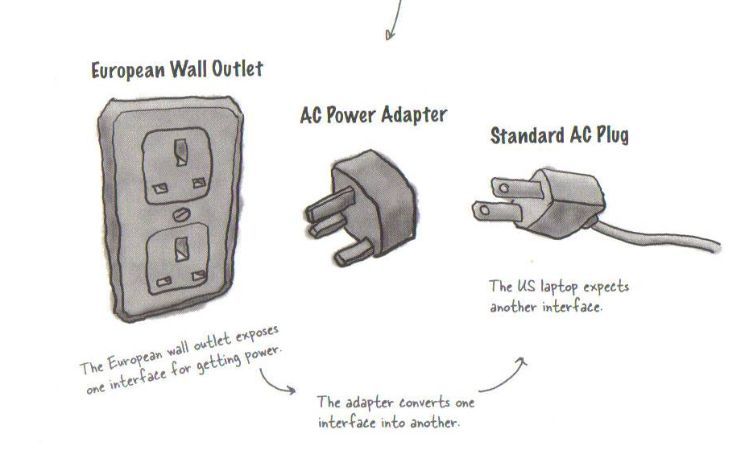
Adapters in real life
Page 236 – Head First Design Patterns

Slide 5
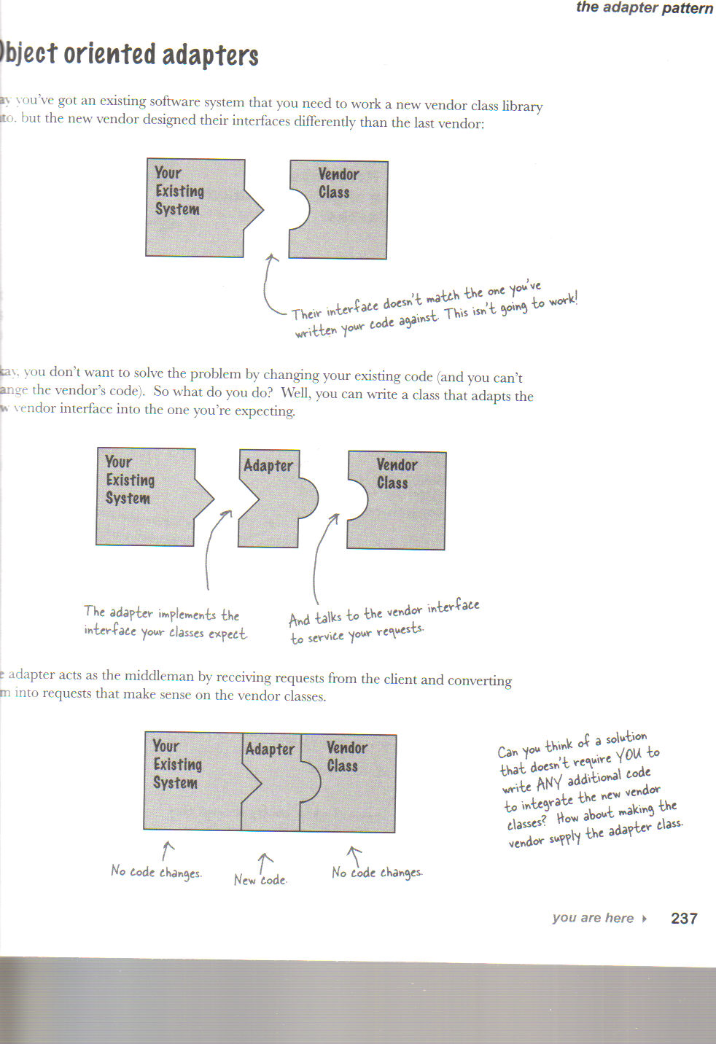
Object-Oriented Adapters
Page 237 Head First Design Patterns

Slide 6
Turkey that wants to be a duck example
public interface Duck {
public void quack();
public void fly();
}

Slide 7
Subclass of a duck – Mallard Duck
public class MallardDuck implements Duck {
public void quack() {
System.out.println("Quack");
}
public void fly() {
System.out.println("I'm flying");
}
}

Slide 8
Turkey Interface
public interface Turkey {
public void gobble();
public void fly();
}

Slide 9
An instance of a turkey
public class WildTurkey implements Turkey {
public void gobble() {
System.out.println("Gobble gobble");
}
public void fly() {
System.out.println("I'm flying a short distance");
}
}

Slide 10
Turkey adapter – that makes a turkey look like a duck
public class TurkeyAdapter implements Duck {
Turkey turkey;
public TurkeyAdapter(Turkey turkey) {
this.turkey = turkey;
}
public void quack() {
turkey.gobble();
}
public void fly() {
for(int i=0; i < 5; i++) {
turkey.fly();
}
}
}

Slide 11
Duck test drive
public class DuckTestDrive {
public static void main(String[] args) {
MallardDuck duck = new MallardDuck();
WildTurkey turkey = new WildTurkey();
Duck turkeyAdapter = new TurkeyAdapter(turkey);
System.out.println("The Turkey says...");
turkey.gobble();
turkey.fly();
System.out.println("\nThe Duck says...");
testDuck(duck);
System.out.println("\nThe TurkeyAdapter says...");
testDuck(turkeyAdapter);
}
static void testDuck(Duck duck) {
duck.quack();
duck.fly();
}
}

Slide 12
Test run – turkey that behaves like a duck
The Turkey says...
Gobble gobble
I'm flying a short distance
The Duck says...
Quack
I'm flying
The TurkeyAdapter says...
Gobble gobble
I'm flying a short distance
I'm flying a short distance
I'm flying a short distance
I'm flying a short distance
I'm flying a short distance

Slide 13
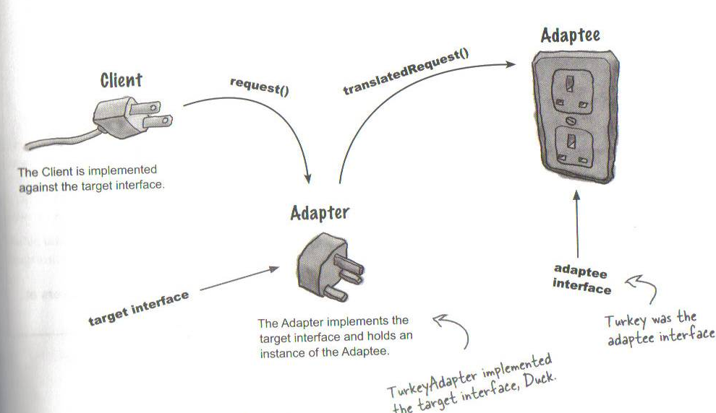
Adapter Pattern explained
Page 241 – Head First Design Patterns

Slide 14
Adapter Pattern defined
The Adapter Pattern converts the interface of a class into another interface the clients expect. Adapter lets classes work together that couldn’t otherwise because of incompatible interfaces.

Slide 15
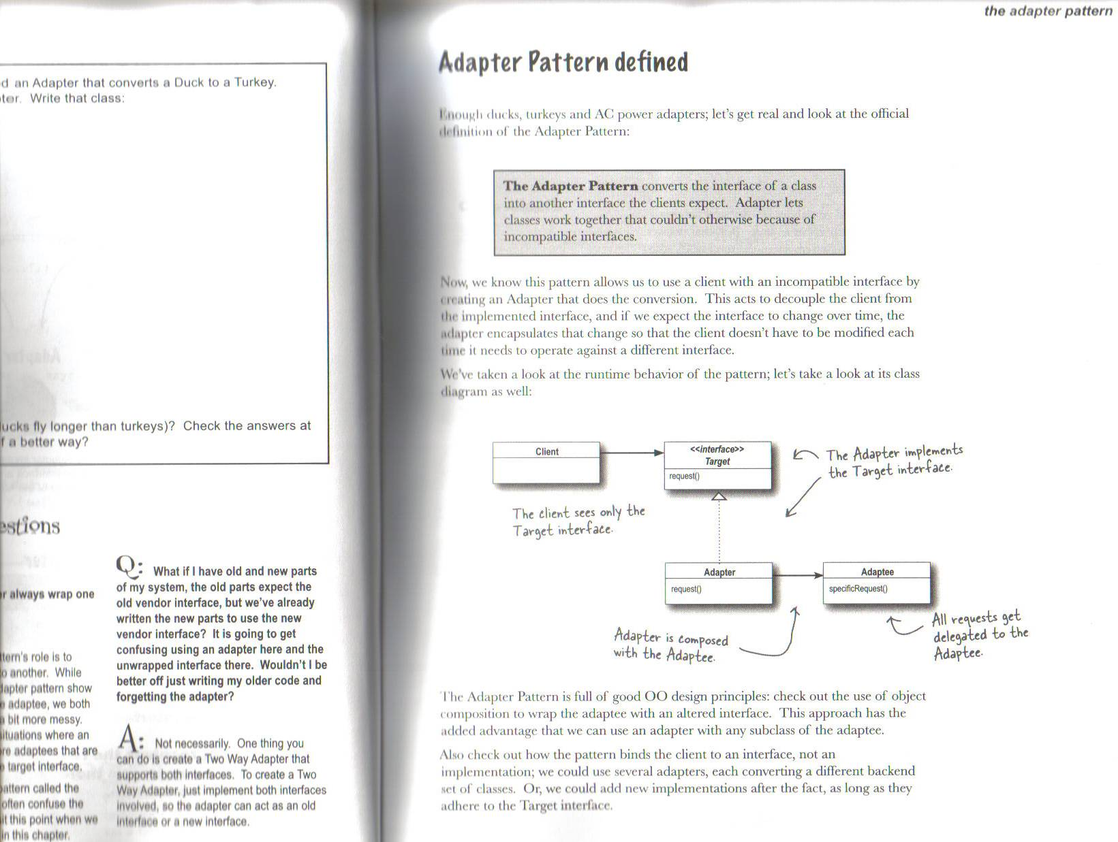
Adapter Pattern
Page 243 – Head First Design Patterns

Slide 16
Summary so far..

